Slide 1


DESIGN 1
Lesson 3: Independent Application: Organizing Real Content
Ms. Abboud • Grade 9 - Design 1 • Term 1, Week 4

Slide 2
Learning Objectives
WALT - We Are Learning To
WILF - What I'm Looking For
Independently choose and build the appropriate list type for real content.
Replace a paragraph with a properly structured list.
My list type choice matches the content.
My content is clearer as a list than it was as a paragraph.

Slide 3
Frayer Model: Unordered List (Review)
DEFINITION
CHARACTERISTICS
A bulleted list (<ul>), used when the order of items doesn't matter.
Items shown with bullets, not numbers; reordering the items doesn't change the meaning.
UNORDERED LIST
EXAMPLES
NON-EXAMPLES
<ul>
<li>Reading</li>
<li>Coding</li>
</ul>
A numbered list of steps in a recipe - order matters, so <ol> fits better.

Slide 4
National Identity Integration
UAE Heritage and Culture: presenting real cultural or heritage content, like a list of UAE landmarks or Emirati values, clearly and with the right list type is part of communicating national identity effectively online.

Slide 5
STARTER
What Could Become a List?
What content on your own website could be turned into a list instead of a paragraph?
Hook • Engage & Ask
5 - 10 minutes

Slide 6
LESSON CORE
I Do: Today's Challenge
Find at least 2 places on your site where a list would organize content better than a paragraph.
Choose the list type that matches - ordered if sequence matters, unordered if it doesn't.
Gradual Release of Responsibility
30 - 40 minutes
Example: turning a paragraph into a list
<h2>My Skills</h2>
<ul>
<li>HTML</li>
<li>Problem Solving</li>
<li>Teamwork</li>
</ul>
1 / 2

Slide 7
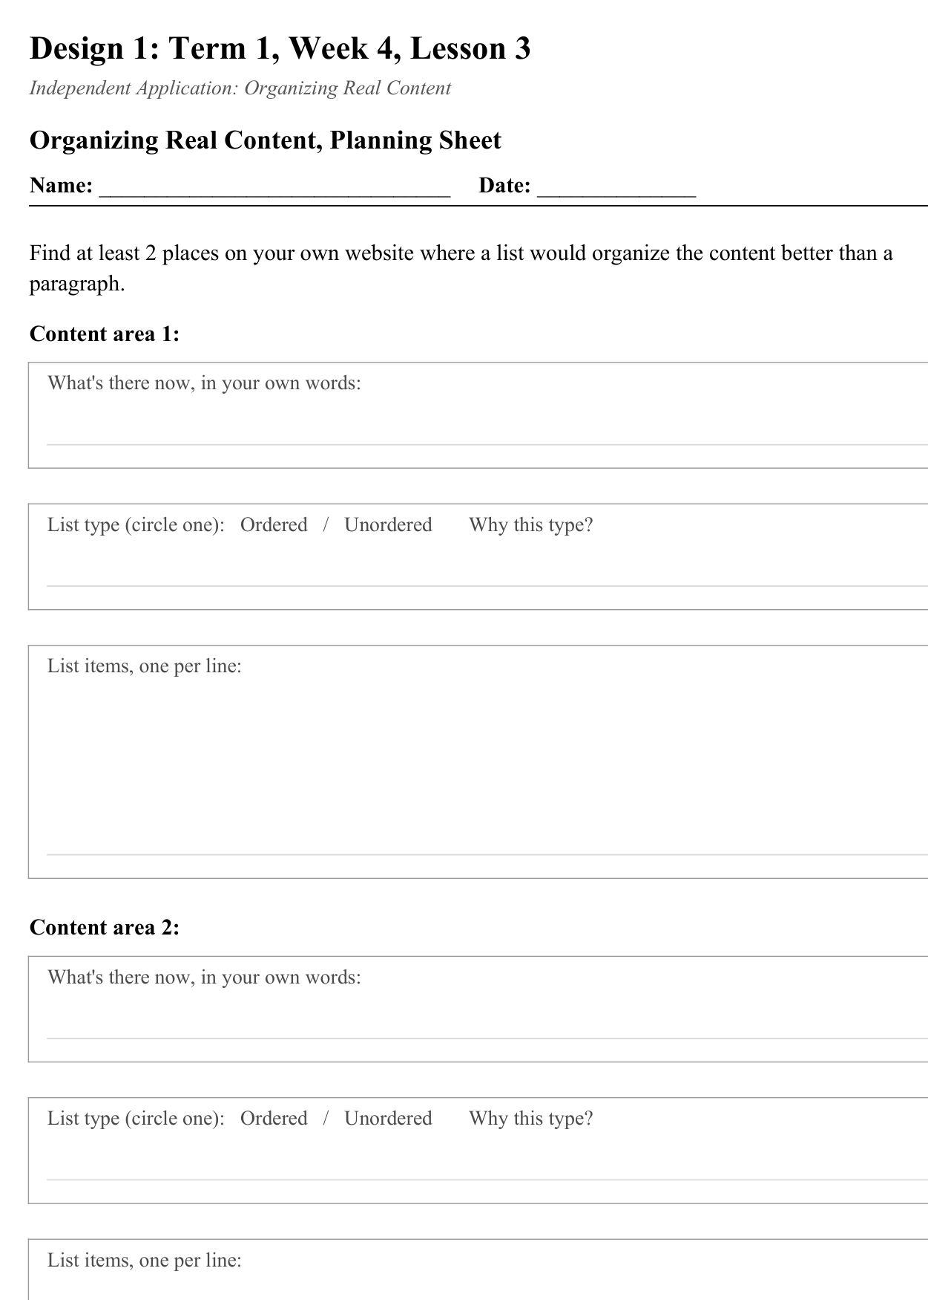
LESSON CORE
You Do: Plan & Build
Replace at least one paragraph with a properly chosen, correctly built list.
Stretch: build a simple navigation-style unordered list styled as a menu.
Activity: Organizing Real Content, Planning Sheet
Gradual Release of Responsibility
30 - 40 minutes
2 / 2

Slide 8
CLOSURE
Teacher Circulation
No formal exit ticket today - teacher circulates for 1:1 feedback on list-type choices.
Transition & Extend
5 - 10 minutes

